Slide 1


Adult Guidelines
Presented by Dr Tom Boyles
Slides developed by Assoc Prof Sipho Dlamini
Division of Infectious Diseases & HIV Medicine
Groote Schuur Hospital

Slide 2
Outline of talk
Guidelines local versus International
TEMPRANO Trial
START Trial
HPTN 052
HIV Clinicians Society Guidelines -2017
Isoniazid Preventative Therapy
Conclusion

Slide 3
Global Scale of Problem
36.7 million people living with HIV
51% of people with HIV know their status
  HIV testing reached its limit
18.2 million people receiving ART
WHO targets to end HIV pandemic
  New guidelines to increase ART coverage
  New set targets for 2020 & 90-90-90 strategy
  End AIDS epidemic by 2030
Copyright -
WHO 2016. All rights reserved.
Notes:
Based on new WHO recommendations, the number of people eligible for ART increases from 28 million to 37million who currently live with HIV
2.1 million newly infected with HIV in 2015 and 1.1 million AIDS deaths in 2015
90-90-90 strategy targets are; 90% of people living with HIV being aware of their HIV infection, 90% of those should receive ART, 90% of people on ART having no detectable virus in their blood

Slide 4
Decline in HIV incidence and mortality over time
Source: UNAIDS/WHO estimates.

Slide 5
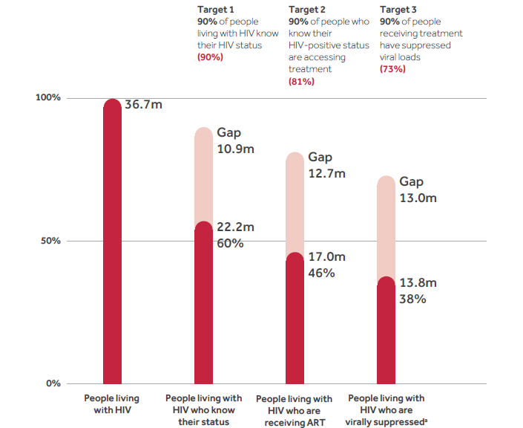
Improvements are needed at each stage of the cascade of HIV testing and treatment services, 2015
Source: UNAIDS/WHO estimates.

Slide 6
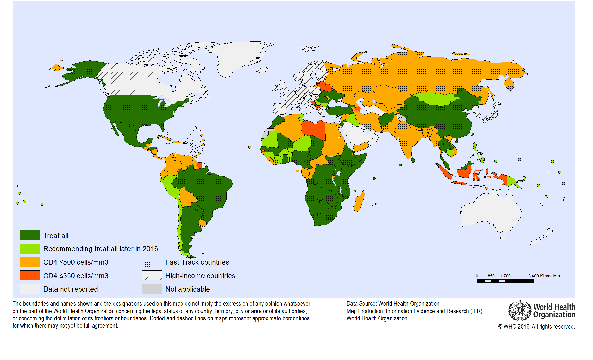
Adoption of the "treat all" recommendation among adults and
adolescents living with HIV, October 2016

Slide 7
South Africa
6.4 million South Africans are HIV-infected
2.6 million have started ART
Estimated ART coverage 42%

Slide 8
Outline of talk
Guidelines local versus International
TEMPRANO Trial
START Trial
HPTN 052
HIV Clinicians Society Guidelines- 2017
Isoniazid Preventative Therapy (IPT)
Conclusion

Slide 9
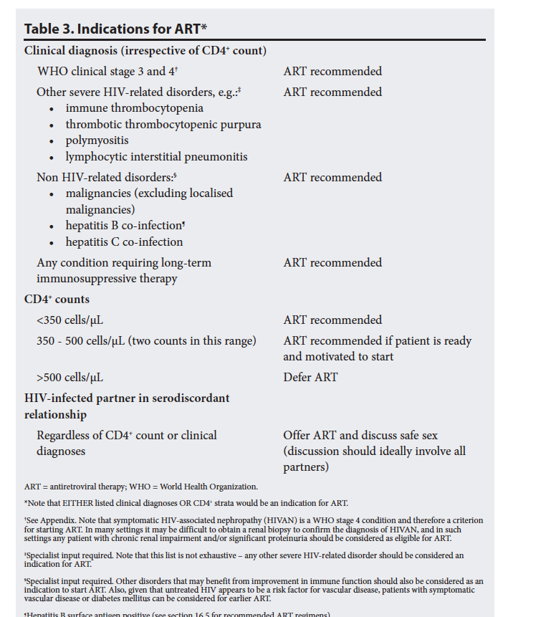
Adult antiretroviral therapy guidelines 2014

Slide 10
Adult antiretroviral therapy guidelines 2015

Slide 11
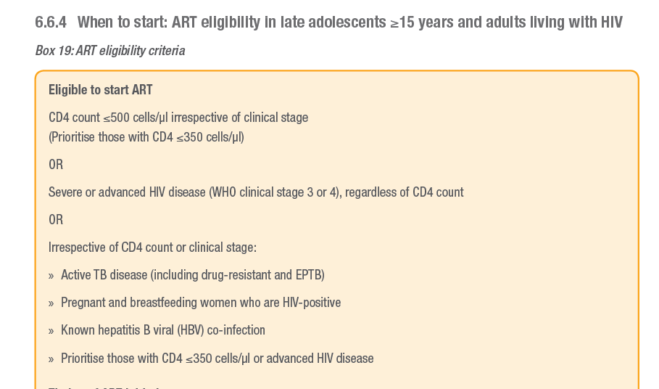
South African Department of Health

Slide 12
2014 Recommendations of the International IAS-USA-Society
Recommendations
Clinicians should provide education about personal health benefits of ART and public benefits of prevention of transmission, and assess patients’ readiness to initiate and adhere to long-term ART. Rating: AIII
ART should be offered upon detection of HIV infection. Rating: A1a
Strategies for adherence support should be implemented and tailored to individual patient needs or the setting. Rating: AIa
Clinicians should be alert to the nonspecific presentation of acute HIV infection and urgently pursue specific diagnostic testing (plasma HIV viral load) if suspected. Rating: AIIa
Marrazzo et al, JAMA, 2014.

Slide 13
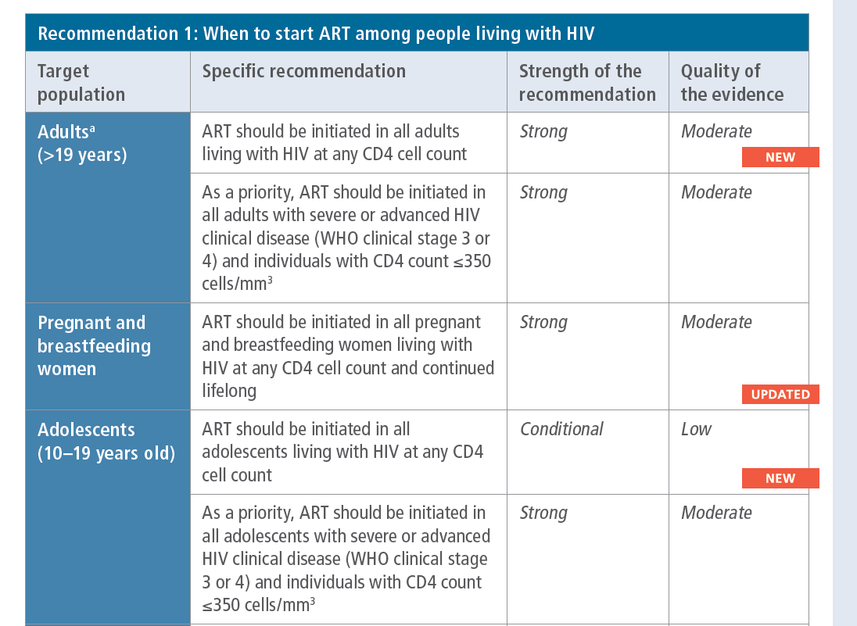
Copyright -
WHO 2015. All rights reserved.

Slide 14
Outline of talk
Guidelines local versus International
TEMPRANO Trial
START Trial
HPTN 052
HIV Clinicians Society Guidelines- 2017
Isoniazid Preventative Therapy (IPT)
Conclusion

Slide 15
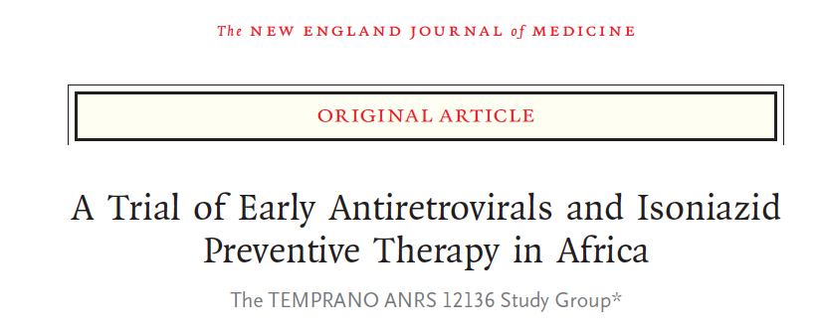
TEMPRANO Trial

Slide 16
Study Site
  Ivory Coast
Trial design
  Unblinded, multicenter, individual-randomized controlled 2-by-2 factorial trial.
HIV positive with CD4 count < 800 cells/mm³
participants randomized to one of four groups
  Deferred ART
  Deferred ART plus IPT
  Early ART
  Early ART plus IPT
Notes:
The trial started in March 2008 and ended in January 2015
The deferred ART group did change during the trial as guidelines changed, changed twice in this trial (initial start was CD4 count of 200 based on 2006 WHO guidelines, then increased to 350 in 2009, then in 2013 raised to 500)

Slide 17
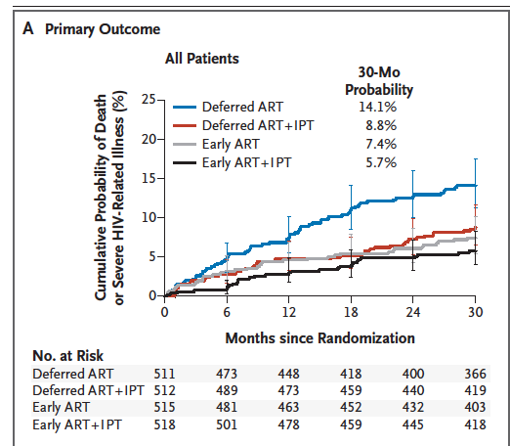
Notes:
Early initiation of ART and 6 months of IPT independently resulted in a risk of severe HIV-related illness that was 44% lower and a risk of death from any cause that was 35% lower than the risks with deferred initiation of ART and no IPT.
Were driven by the efficacy of both interventions in preventing tuberculosis

Slide 18
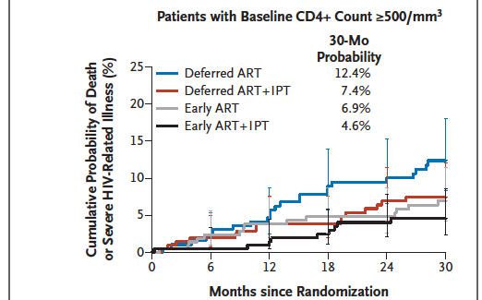

Slide 19
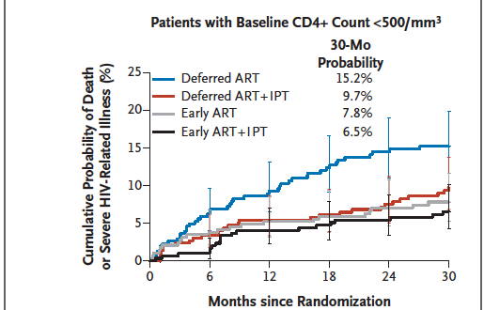

Slide 20
Outline of talk
Guidelines local versus International
TEMPRANO Trial
START Trial
HPTN 052
HIV Clinicians Society Guidelines- 2017
Isoniazid Preventative Therapy (IPT)
Conclusion

Slide 21
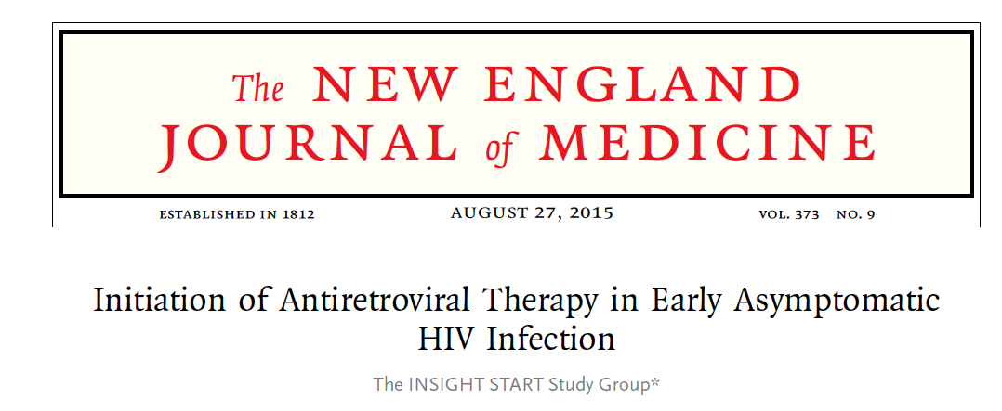
The START Trial

Slide 22
Multicontinental randomized trial
  215 sites in 35 countries
Study participants
  HIV positive > 18 years
  Not yet initiated on ART with no history of AIDS
  CD4+ counts >500 cells/mm³
  Pregnant and breast feeding women not eligible
Randomized to
  Immediate ART or
  Deferred initiation until the CD4+ count declined to 350 cells/mm³
Notes:
START was a trial to determine the risks and benefits of immediate initiation of ART in asymptomatic HIV-positive patients who have CD4 count >500 cells/mm³ as compared with deferring initiation until CD4+ count is 350 cells/mm³.
Study initiated in 2009, during the course of the study treatment guidelines changed, because the evidence prompting these changes was limited, the trial did not revise the deferred-initiation strategy.
On 15 May 2015 the board informed the study leadership that the primary question of the study had been answered and recommended that the findings be immediately disseminated.

Slide 23
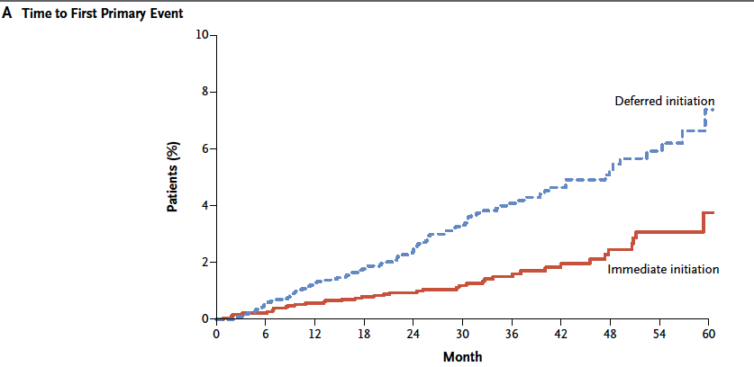
Notes:
Primary end point was a composite outcome that included two major components, any serious AIDS-related event (including death from AIDS) or any AIDS-defining event. The second component was any serious non-AIDS-related event, including death from causes other than AIDS.
From this trial immediate initiation of ART was superior to deferred ART, beneficial effect evident for both serious AIDS-related and non-AIDS-related events.

Slide 24
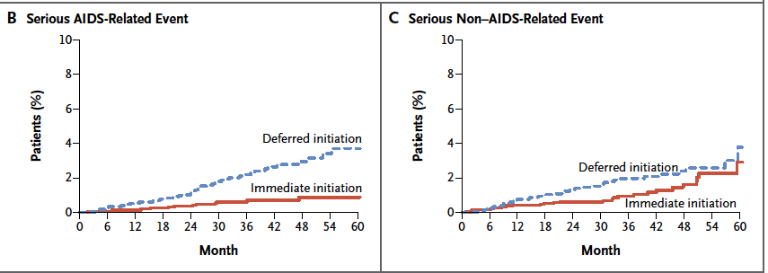
Notes:
The three most frequent serious AIDS-related events (tuberculosis, Kaposi’s sarcoma and malignant lymphomas), most of the tuberculosis events occurred in Africa.
Two of the most frequent non-AIDS- related events (non-AIDS cancer and cardiovascular disease) occurred in patients from Australia, Europe, Israel and the US.

Slide 25
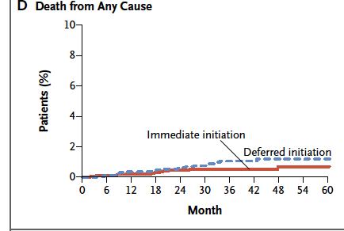

Slide 27
Outline of talk
Guidelines local versus International
TEMPRANO Trial
START Trial
HPTN 052
HIV Clinicians Society Guidelines- 2017
Isoniazid Preventative Therapy (IPT)
Conclusion

Slide 28
HPTN 052
Worldwide multicentre randomized controlled trial
  Early versus delayed ART
  HIV infected adults with CD4 counts of 350-550 cells/mm³
93% reduction in HIV transmission to sexual partner
Delayed time to AIDS events with early treatment

Slide 29
Summary
HPTN 052
START
TEMPRANO
ART recommended irrespective of CD4+ count (CD4+ Count no longer a gate keeper to ART)

Slide 30
Outline of talk
Guidelines local versus International
TEMPRANO Trial
START Trial
HPTN 052
HIV Clinicians Society Guidelines- 2017
Isoniazid Preventative Therapy (IPT)
Conclusion

Slide 31
Baseline resistance test
Only recommend baseline resistance test for following situations
Pre-exposure prophylaxis (PrEP)- in last 6 months
History of sexual exposure to a person with known drug resistant HIV
Or known to have failed an ART regimen

Slide 32
First Line Regimens
Initial ART Regimens for the previously untreated patient
The preferred First-line regimens
TDF + emtricitabine (FTC) (or 3TC) + efavirenz (EFV) Or
TDF + emtricitabine (FTC) (or 3TC) + dolutegravir (DTG) or
TDF + emtricitabine (FTC) (or 3TC) + rilpivirine (RPV) provided VL < 100,000 copies/mL
Rilpivirine cannot be used with rifampicin & dolutegravir requires dose adjustment with rifampicin

Slide 33
Commencing ART in patients with TB or OIs
CM and TBM
  Start 4-6 weeks
PCP and other OIs
  Start within 2 weeks
TB if CD4 < 50
  Start within 2 weeks
TB if CD4 > 50
  Start 2-8 weeks
  IRIS risk and operational issues

Slide 34
Second-line regimens
Recommend a regimen of 2 NRTIs and a ritonavir (RTV)- boosted (/r) PI
The preferred PI in Second-line regimens
Atazanavir (ATV) 300 mg / RTV 100mg daily or
Lopinavir (LPV)/r BD
NRTI combinations advised for second-line regimens:
AZT + 3TC or
TDF + 3TC (FTC can be substituted for 3TC)
Draw backs of ATV: -cannot be used with rifampicin- based TB therapy - Important drug interactions with drugs that reduce stomach acidity such as proton pump inhibitors

Slide 35
Choice of second-line NRTIs in relation to first-line NRTIs used
First-line NRTIs used | Second-line NRTI combination advised
AZT + 3TC | TDF + 3TC*
d4T +3TC | TDF + 3TC*
TDF + 3TC* | AZT + 3TC
ABC + 3TC | AZT + 3TC
*3TC is interchangeable with FTC.

Slide 36
Dosing of ART drugs and rifabutin when prescribed concomitantly
ART drug | ART dosage | Rifabutin dosage
EFV | No change | Increase to 450 mg/day
NVP | No change | 300 mg/day
ATV or RTV-boosted PIs | No change | Decrease to 150 mg/day (monitor ALT, neutrophils and visual symptoms at least monthly)

Slide 37
Third-line ART Regimens
Indicated for patients with documented PI resistance
Requires resistance testing before regimen chosen
Must have been on PI-based second line regimen for longer than 1 year
Criteria for resistance testing on second-line ART
  2 or 3 VL > 1000 copies/mL in 6 month period
  Exception- error of not double dosing of LPV/r with rifampicin

Slide 38
Repeat VL after 6 months
VL > 1000 copies/mL
Specialist referral
GENOTYPE
Specialist decision further management
VL >1000 copies/mL on PI-based ART > 1 year
Adherence; compliance; tolerability; drug interactions; psychological issues
VL ≤ 1000 copies/mL
Continue second-line

Slide 39
Drugs available for third-line ART
PI | Darunavir (DRV)
InSTI | Dolutegravir (DTG)
InSTI | Raltegravir (RAL)
NNRTIs | Etravirine (ETR) Rilpivirine (RPV)
CCR5 blocker | Maraviroc (MVC)
First-generation NNRTIs (NVP & EFV) have no place in third-line therapy as they do not impair viral fitness

Slide 40
Add DTG
TDF/AZT 30-59 OR DRV ≥ 15
Eligible for third line ART?
PI score ≥ 15
DRV/r
PLUS
3TC/FTC
PLUS
AZT/TDF (lowest score)
TDF/AZT > 29 AND DRV ≥ 15 AND ETR ≤ 29
Add ETR

Slide 41
Outline of talk
Guidelines local versus International
TEMPRANO Trial
START Trial
HPTN 052
HIV Clinicians Society Guidelines- 2017
Isoniazid Preventative Therapy (IPT)
Conclusion

Slide 42
Isoniazid Preventive Therapy (IPT)
TEMPRANO : separate randomisation to 6 months of IPT
  addition of IPT to ART- provided added protection against active TB disease
  Benefit to patients with relatively high CD4 counts
Khayelitsha study- placebo-controlled
  12 months of IPT to patients on ART
  reduced TB incidence by 37%

Slide 43
Indications for and duration of IPT
TST | Pre-ART* | On ART
Not done | IPT for 6 months | IPT for 12 months
Negative | IPT not indicated | IPT for 12 months
Positive | IPT for at least 36 months | IPT for at least 36 months
IPT = isoniazid preventive therapy; TST = tuberculin skin test; ART = antiretroviral therapy. *This would only apply in the case of a patient wishing to defer ART initiation.

Slide 44
Outline of talk
Guidelines local versus International
TEMPRANO Trial
START Trial
HPTN 052
HIV Clinicians Society Guidelines- 2017
Isoniazid Preventative Therapy (IPT)
Conclusion

Slide 45
Conclusion
CD4⁺ count no longer a barrier to ART initiation
Earlier ART benefits all HIV-infected individuals
  reduces risk of disease progression
  prevents HIV transmission
Benefits to early ART in developing countries
  reduce TB rates
IPT for all patients on ART

Slide 46
Acknowledgements and thanks to:

